Slide 1




Yr9 Parent Information Evening

Slide 2
Miss Bliss
Headteacher
Mrs Hills
Assistant Head
Miss Jackson
Head of Year & Mental Health Lead
The purpose of tonight:
Year 9 is about choice, maturity and preparation.
The year of opportunity!

Slide 3

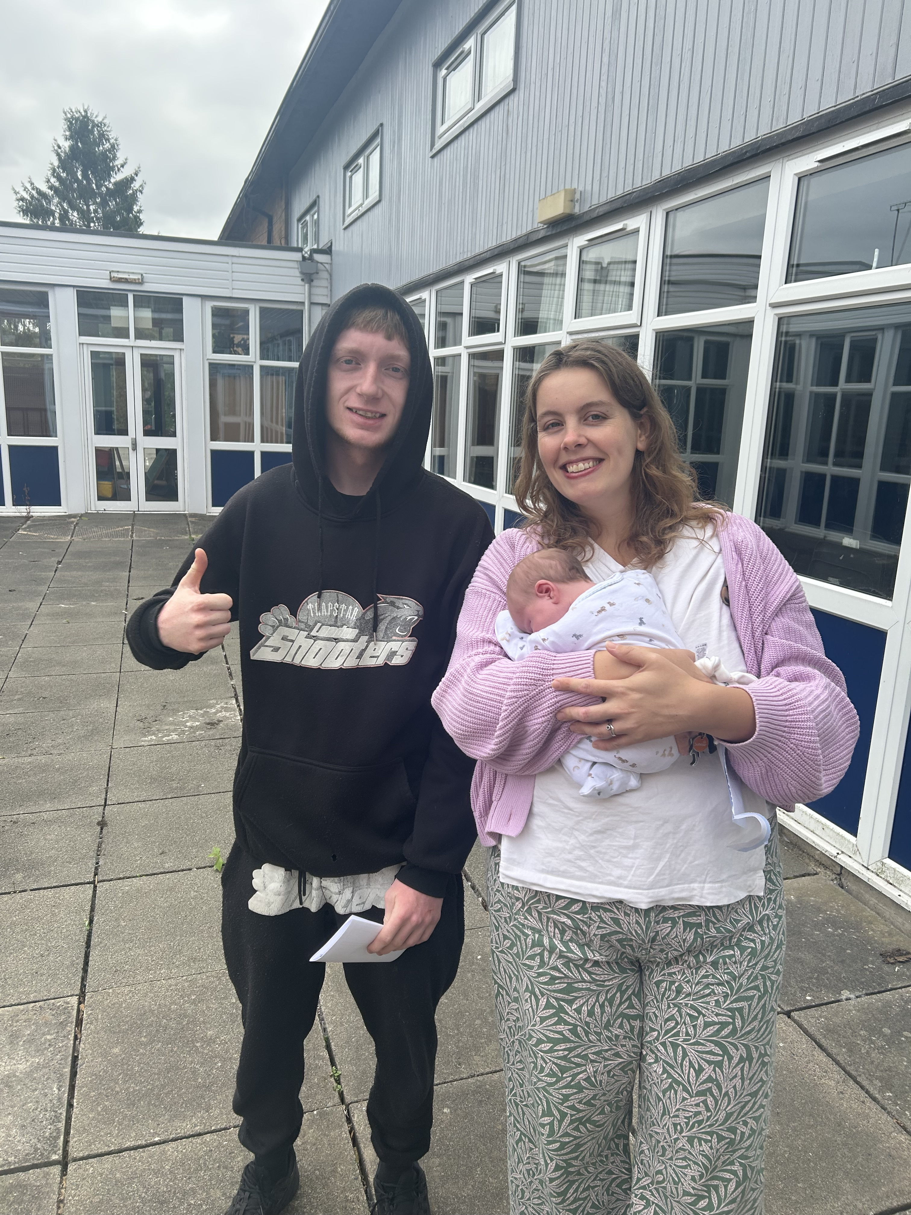
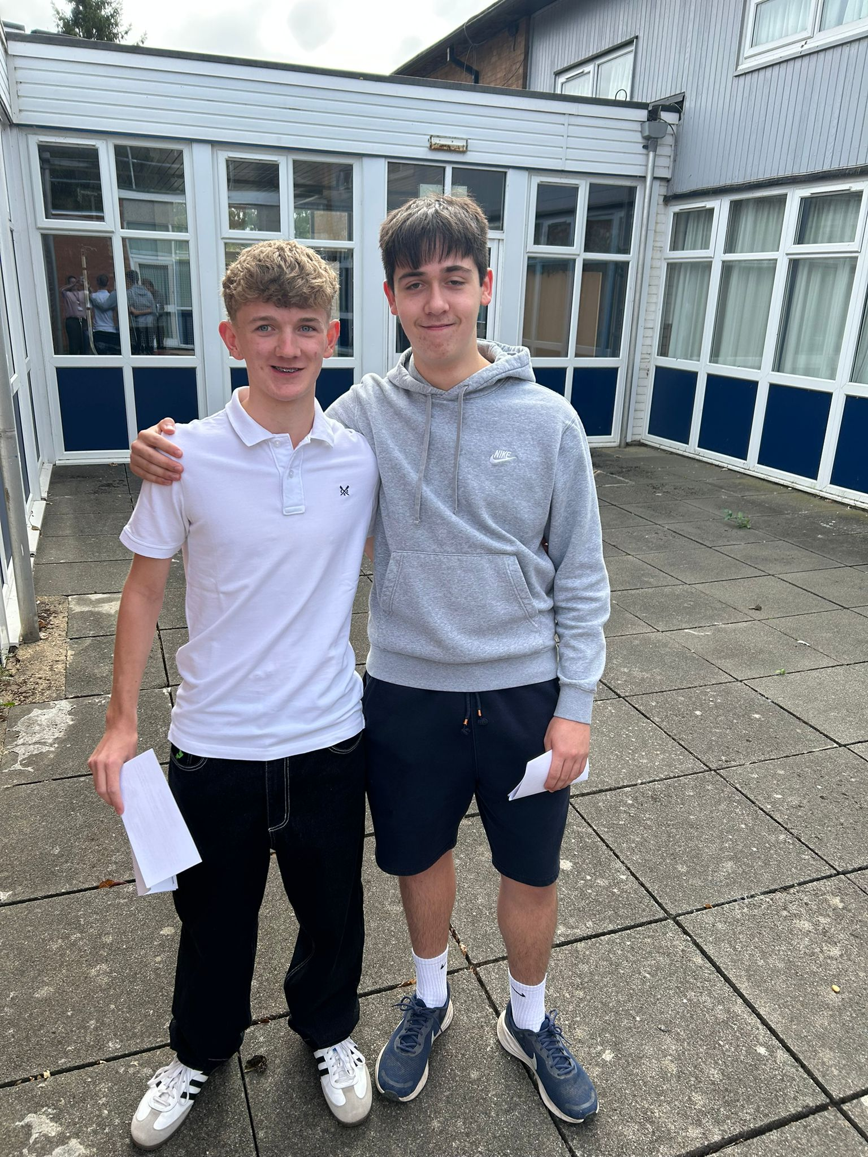
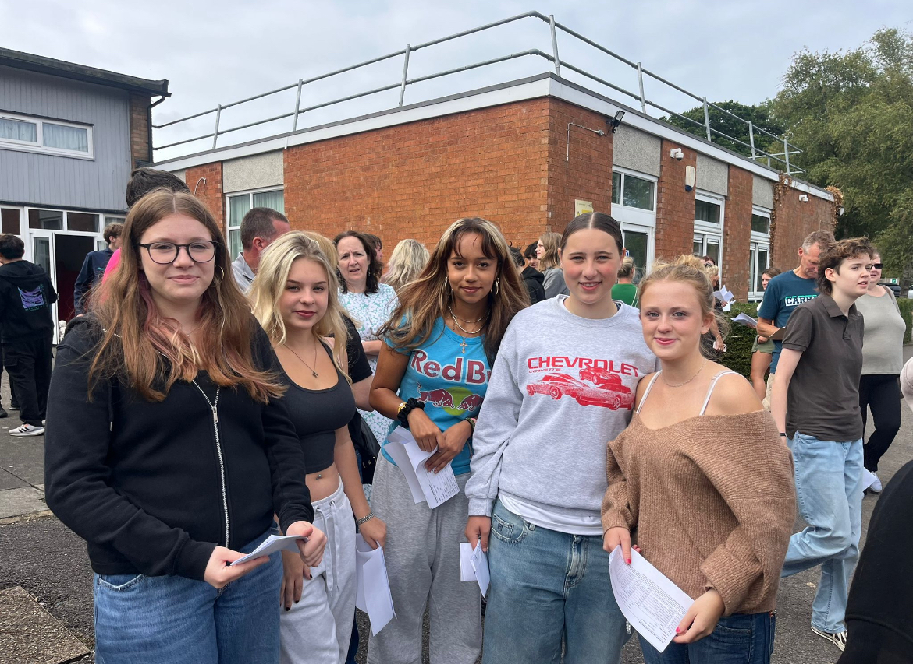

GCSE Results – August 2025
Class of 2025
% students achieving 5 (G9-4): 70%
% of grades Grade 7+: 18%
16 % of students achieved a Grade 9 spread across 14 different subjects
Overall Pass rate: 99.1%
Progress score: +0.34

Slide 4
By comparison
Post 16 placements include Piggots, Highdown, The Forest School, Reading Boys, Reading BlueCoat, Henely College, Reading College, BCA and various apprenticeships including: Childcare, hair & beauty, mechanics and plastering.
Measure | 2024 | 2025
No. | 71 | 68
A8 | 37.4 | 44.3
P8 | -0.42 | +0.34
En 4+ | 59% | 71%
Ma 4+ | 49% | 71%
5+ (4-9) | 44% | 69%
En 7+ | 10% | 17%
Ma 7+ | 10% | 24%
% (7-9) | 9% | 18%
% Grade 9 | 1% | 4%
Last year’s cohort of Year 11 are broadly comparable (by prior attainment) to this Year 10 group – therefore our baseline targets measures are to match, if not exceed, the headline figure results!
How did they do it?
Strong attendance in lessons
Use of tutor time for targeted intervention at key times of the year
Engaged with homework and opportunities provided to do “a little extra”
Goal Setting and getting a Post 16 plan in place
A “little, but often” approach… avoided burnout and students could feel their progress

Slide 5

A fantastic start!
TOTAL: 4,242
Which is an average of 49 per pupil!
Getting into a new routine
Meeting expectations
Building positive relationships
Putting in the hard work
Attending clubs
Notes:
Meeting expectations – that’s meant for us and them. The children are learning our expectations, and from the feedback from students so far MECE is doing a good job of meeting theirs too!
Transition in tricky circumstances – overcome more barriers than other years. We are proud of them.
Encouraging students to develop positive relationships with staff and peers
Then the hard work starts…

Slide 6


Our Expectations
To be prepared and on time
Smartly presented
Homework to be completed
Work hard
Polite and respectful
Get involved!
Enjoy themselves!
Notes:
Please encourage your son/ daughter to arrive to school on time. School opens to students at 8:30am, tutor starts at 8:40. This gives them 10mins to go to locker/ sort bags – if they are on time.

Slide 7
When you think of Year 9, You think of…
Parents’ Perspective
“The Options process feels like such a big decision.”
“They’re more independent… but also more opinionated.”
“Motivation comes and goes – one week focused, the next week distracted.”
“I want to guide them, but I don’t want to push too hard.”
“Are they really ready for GCSEs?”
Students’ Perspective
“Finally, I get a say in what I study.”
“Taster lessons are exciting – but also stressful.”
“I want to choose the same options as my friends.. But I also want to do well.”
“GCSEs still feel far away… until someone says, ‘PPEs in the summer’.”
“I want to be treated like an adult, but sometimes I just want things easy.”
The Reality
Year 9 is a transition year – independence grows, but support is still strong.
It’s about curiosity, exploration, and starting to take ownership of learning.
Options decisions feel huge, but students are supported every step of the way.
Notes:
Meeting expectations – that’s meant for us and them. The children are learning our expectations, and from the feedback from students so far MECE is doing a good job of meeting theirs too!
Transition in tricky circumstances – overcome more barriers than other years. We are proud of them.
Encouraging students to develop positive relationships with staff and peers
Then the hard work starts…

Slide 8
When We think of Year 9, We think of…
Choice
Students exploring subjects that match their strengths and interests.
First taste of shaping their own learning journey.
Growth
Learning how to manage independence, friendships, and responsibility.
Developing the resilience needed for Key Stage 4.
Opportunities
Option taster sessions, enrichment activities, leadership roles.
PPEs in Summer: First “real” exam experience, building confidence.
Support
Tutors, subject teachers, careers guidance – parents aren’t alone in this.
Structured pathways to ensure the right choices for every student.
Aspiration
- Year 9 is about laying the foundations –GCSEs are coming, but this is where the future starts.
Notes:
Meeting expectations – that’s meant for us and them. The children are learning our expectations, and from the feedback from students so far MECE is doing a good job of meeting theirs too!
Transition in tricky circumstances – overcome more barriers than other years. We are proud of them.
Encouraging students to develop positive relationships with staff and peers
Then the hard work starts…

Slide 9
The Options Process
Straw poll: Not final, just an indicator.
Taster sessions: “Try before you choose” in different subjects.
Options evening: Full information for parents and students.
Final decision: Supported by teachers, tutors and careers lead.
Reassure: No doors close if chosen carefully.

Slide 10
The Year 9 Journey…
Autumn Term:
Year 9 settling, building strong habits.
Spring Term:
Friday 27th Feb – Year 9 Parents’ Evening
w/c 2nd March – Year 9 DCP Drop
Options Process (Spring/Summer Term):
Straw poll → Option Taster Sessions → Options Evening → Final Options.
Summer Term:
w/c 27th April – Prep for PPEs
June/July – Year 9 PPEs – first real exam experience.
Notes:
Emphasise how students are guided through choices (assemblies, careers advice, tutor support).

Slide 11
Academic Development
Building GCSE-ready skills: Extended writing, Revision Methods, Exam-style responses.
PPEs give an early experience of formal exams, so Year 10 isn’t a shock.
Consistency is key! Attendance, homework, effort!

Slide 12
Keeping in contact with us
We encourage open conversations with the school if you have a question or concern. Please be mindful that teaching staff do not necessarily have access during the day to their emails but will endeavour to respond within 48 hours
Who to contact first?
Form Tutor – first point of contact for most issues
Head of Year– wellbeing, behaviour, settling in
Subject Teacher – subject-specific queries
Inclusion Team (via the school office in the first instance) – support for additional needs
Absence & medical Team – absence and medical issues
School Office –admin, general enquiries

Slide 13
Year 9
Tutor Time
A rota of activities to support students with reading and life skills, also incorporating activities from Assemblies supporting the PSHE curriculum
Pastoral and progress support/mentoring
Communication between teachers / tutors / HOY
Opportunities for students to enrol in the mentoring programme and develop their own leadership skills
Weekly catch up with tutors

Slide 14
Year 9 Tutor Programme
Day | Focus Area | Details
Monday | Admin / SEAL Programme | Admin slides, updates, notices, uniform check, tools for learning check. Week 1 – Who’s in the Room? Week 2 – What Do We Stand For? Week 3 – Who Inspires Us? Week 4 – Our Group Personality Week 5 – Build the Board
Tuesday | Tutor reading | Lord of the Flies ​ (William Golding) ​ Ethics of society / loss of innocence ​ The Curious Incident…. ​ (Mark Haddon)​ Difference / SEN / perspective Flowers for Algernon ​ (Daniel Keys)​ Human relationships / intelligence /friendship​ The Other side of Truth ​ (Beverley Naidoo)​ Tolerance / asylum / prejudice
Wednesday | Tutor reading
Thursday | Assembly
Friday | Values/ Careers & Aspirations | Unifrog tasks, employer spotlight videos, CV building, career paths, PiXL.

Slide 15
Year 9 Tutors
9A – Mr Khan – am.khan@maidenerleghtrust.org
9B – Mr Kafroshi – j.kafroshi@maidenerleghtrust.org
9C – Mrs Lategan – k.lategan@maidenerleghtrust.org
Notes:
The best way to get in touch is by emailing. We all are teaching, so cannot guarantee to be able to take a call during school hours

Slide 16
Communication & Partnership
How can you support you student and the school?
Ask about taster lessons and subjects.
Attending Parents’ Evening and Options Evening.
Support revision ahead of PPEs.

Slide 17

Class Charts
Vital information for you to support your child's education
Positive and negative points
Organisation (homework tasks)
Absence reporting
88.4% parental engagement currently
If you are having issues onboarding, then please let us know and we can help!

Slide 18
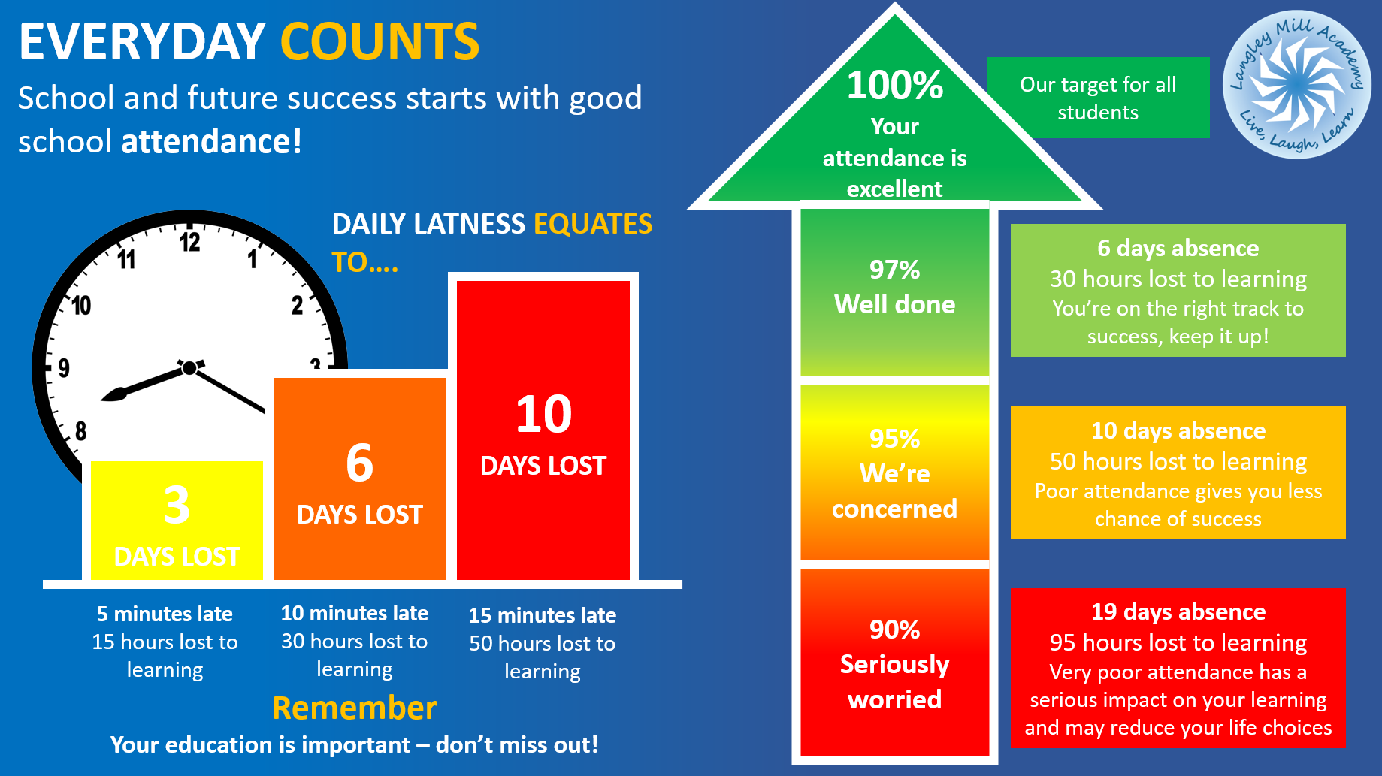

Attendance
Current Y9 attendance:
95%

Slide 19
Teaching and Learning at MECE

Slide 20
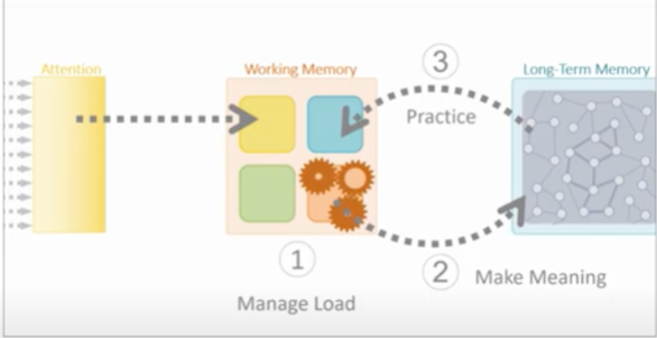
The science behind learning
Attention – keeping our learning environment distraction free, eg tools for learning, quiet work
Working memory – is very limited! Use our exercise books to make helpful notes and off-load our working memory, exercise books live at home
Long term memory – is the key! Practice and contextualising learning are crucial both in school and at home, using knowledge organisers
Working Memory
Long term memory
Attention
https://www.youtube.com/watch?v=zPNwWK7T39k

Slide 21
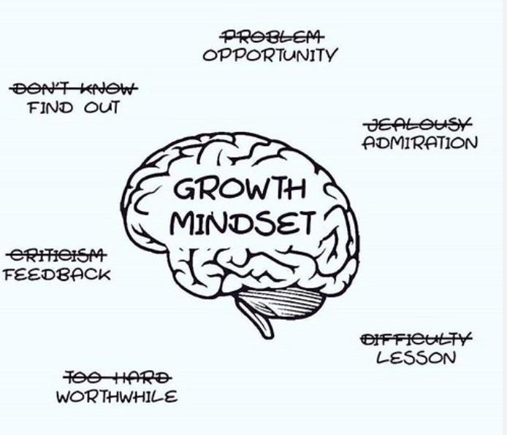
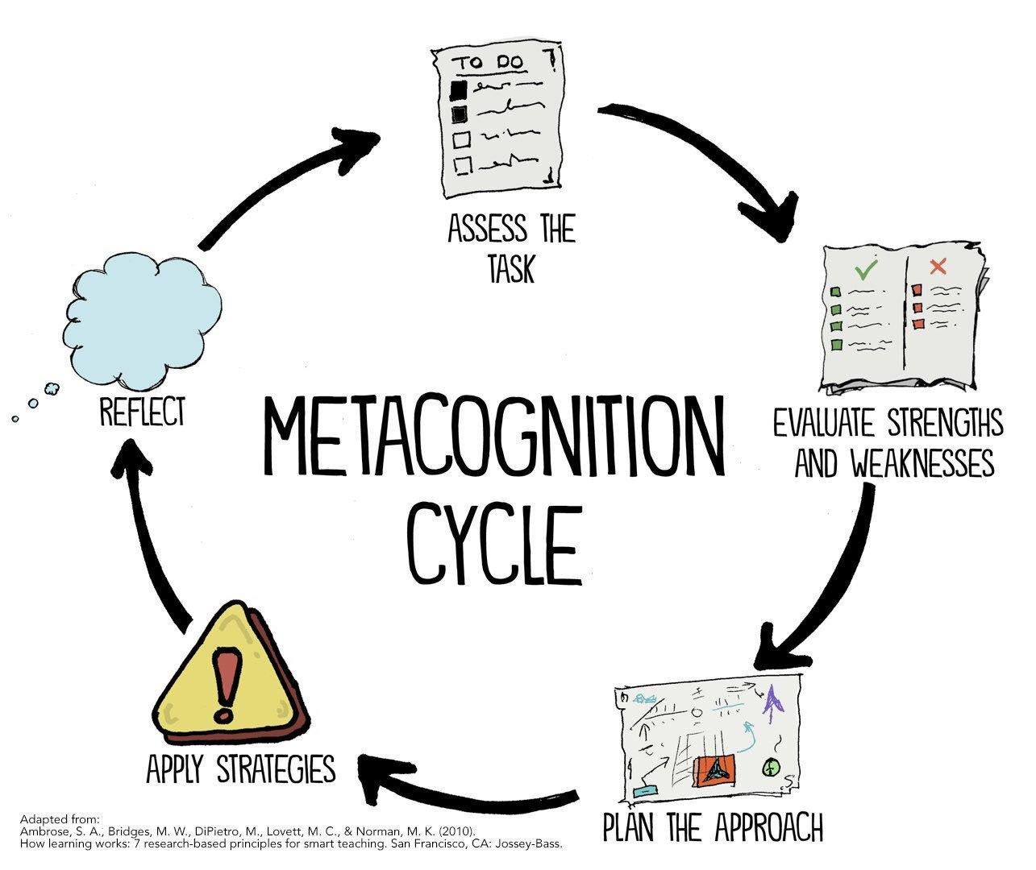
Improving your long term memory
Growth Mindset
Metacognition

Slide 22

Learning at home
Why?
Embedding homework habits is crucial for success at KS4
Homework habits are good for general life skills of organisation, accountability and independence
The time to work and think independently helps embed information into the long-term memory
Spaced practice is important to improve long term memory

Slide 23



What homework will look like
Regular
Set on ClassCharts
Will vary according to subject but will include
  Retrieval practice
  Learning vocabulary
  Reading tasks
Homework Club:
  3.15- 4.15pm Tuesday & Wednesday
  In the library
  The 25 bus will now stop outside school

Slide 24
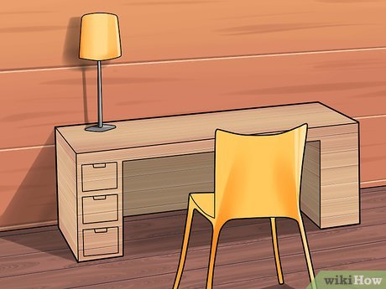
Top tips for home learning success
Find somewhere quiet to work
Free yourself from distractions: TV, phones, friends, social media etc
If you find music helps you focus, choose music WITHOUT lyrics!
General good practice for learning: eat a healthy diet, get a good night’s sleep and exercise regularly, all of these reduce stress.

Slide 25
Final thought…
Year 9 is not just a stepping stone – it’s where students discover what excites them, what they’re good at, and where they want to go.
By Summer 2026, they’ll be ready for GCSEs with clarity and confidence.

Slide 26
Thank you for coming!
#MECEFamily
Notes:
Meeting expectations – that’s meant for us and them. The children are learning our expectations, and from the feedback from students so far MECE is doing a good job of meeting theirs too!
Transition in tricky circumstances – overcome more barriers than other years. We are proud of them.
Encouraging students to develop positive relationships with staff and peers
Then the hard work starts…

