Slide 1



Welcome to Maiden Erlegh Chiltern Edge’s Maths Department
Please view in slideshow mode to hear HOD’s voiceover
Head of Mathematics: Mrs J Chopra
Email: j.chopra@maidenerleghtrust.org

Slide 2
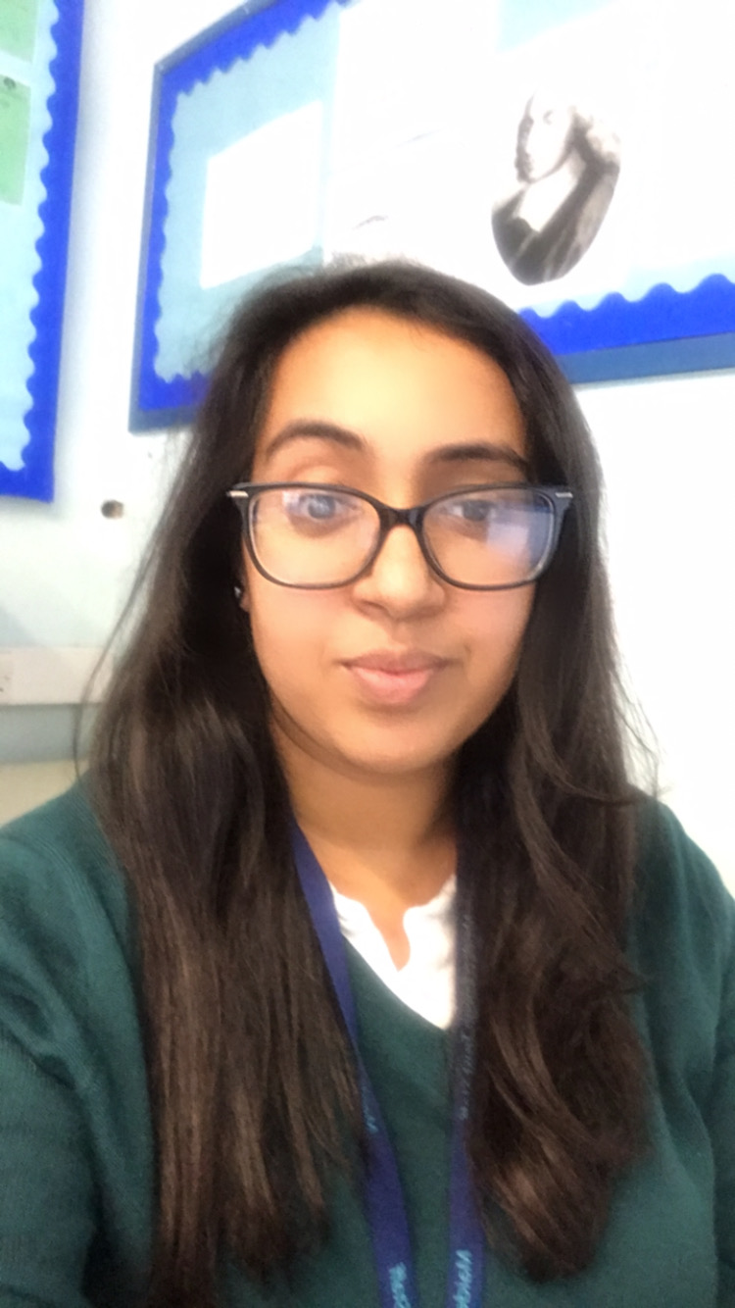
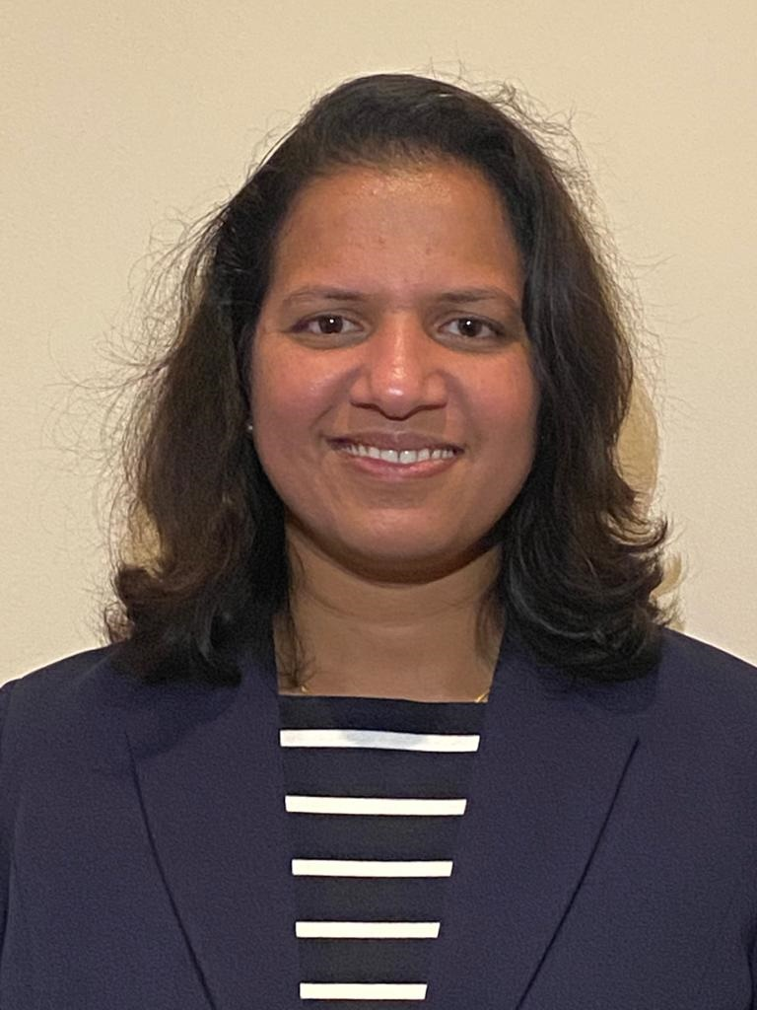
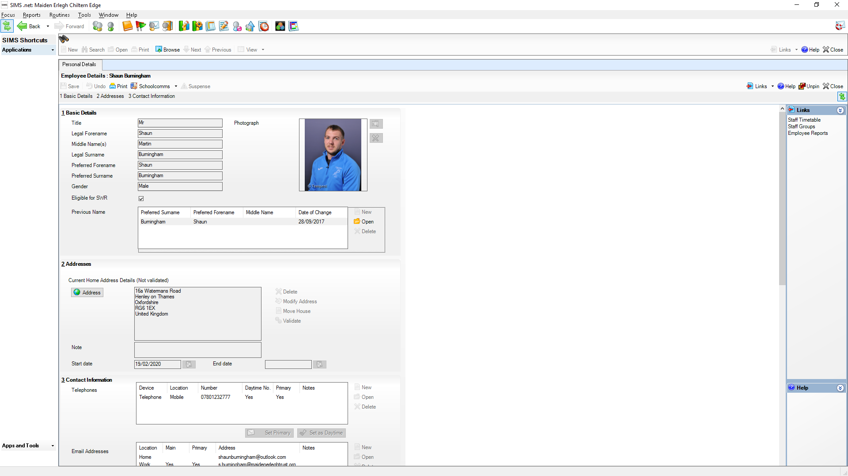
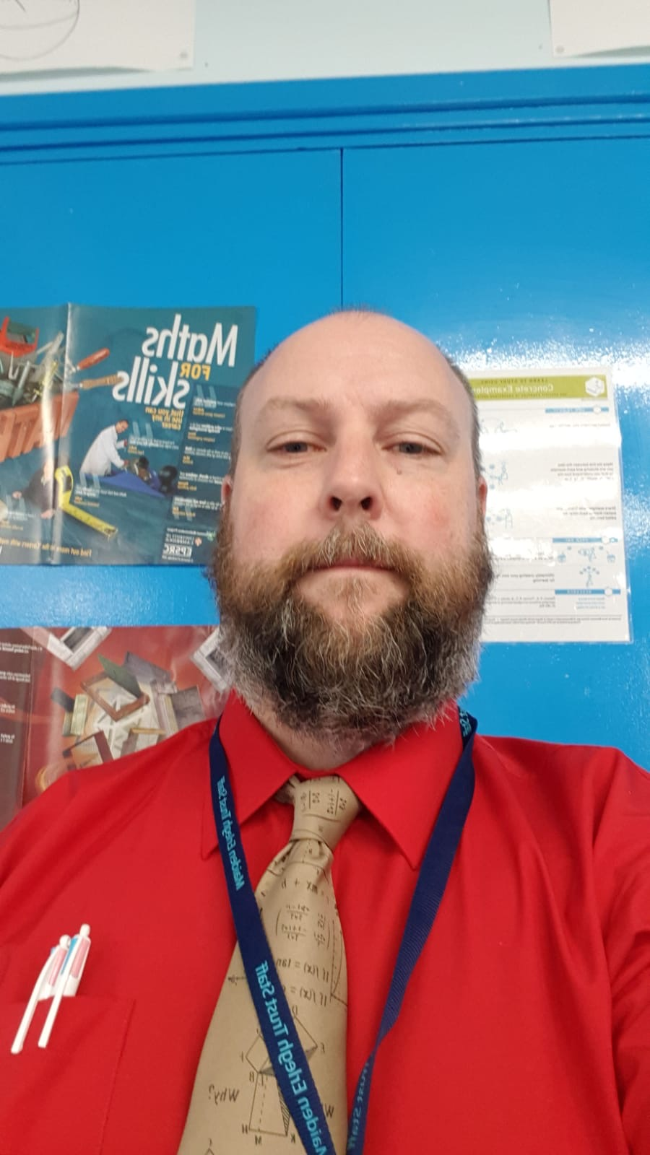
Meet Our Maths Team
Mrs J Chopra
Head of Maths
Mr S Jones
KS3 Lead Maths
Mrs S Gopal
Teacher of Maths
Mr S Burningham
Teacher of Maths & PE

Slide 3
Setting and Assessment
Year 7: Students are given a baseline test and set accordingly. Each year group is set according to ability.
Teachers will match the correct level of challenge and support for each individual student in their content delivery.
Students will sit two assessment every half term. One will be an end of topic test and another an end of term.
Students will be given an analysis sheet after every assessment to help them identify their weaknesses and strengths. Students will also be given the opportunity to iron out any misconceptions using our online platform MathsWatch and the support of their tutor.
Students will have early exposure to GCSE content to allow them to gain confidence, familiarity and exam technique through starter packs, homework and in everyday teaching.
Students will sit their full first set of mocks in year 9 with plenty of practice throughout the years to come.
Head of Mathematics: Mrs J Chopra
Email: j.chopra@maidenerleghtrust.org

Slide 4


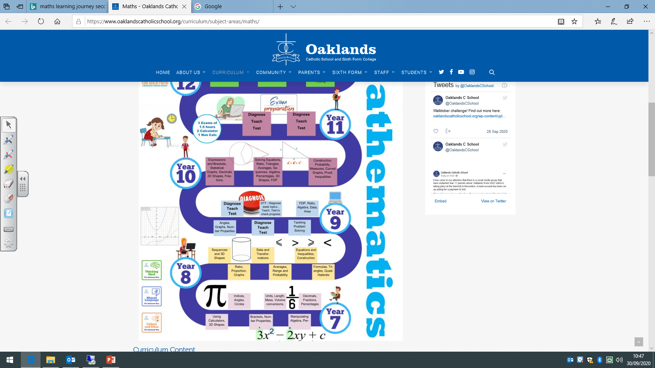
Course Overview & Content
(Higher & Foundation)
Please click here to access the foundation content overview for years 7 – 11
Please click here to access the higher content overview for years 7-11
MECE MATHS 2020 LEARNING JOURNEY
Head of Mathematics: Mrs J Chopra
Email: j.chopra@maidenerleghtrust.org

Slide 5
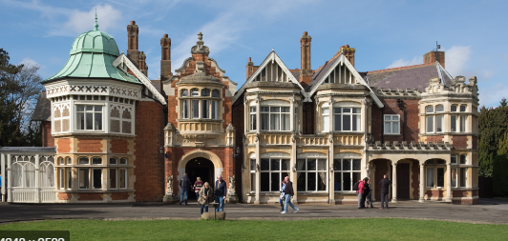
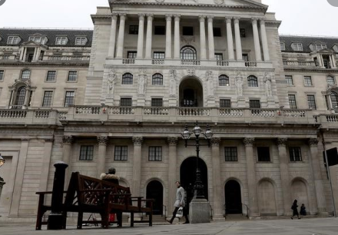
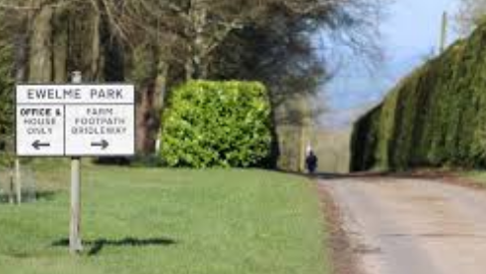
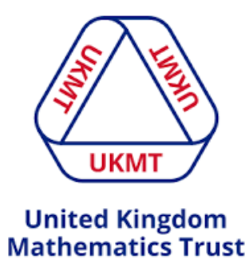
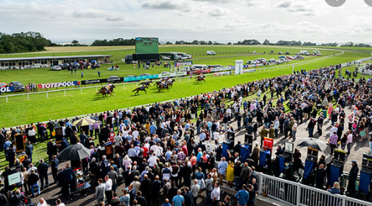
Extra Curricular
The Bank of England
Bletchley Park
Ewelme Park
UKMT Challenge
Racecourse Days
Head of Mathematics: Mrs J Chopra
Email: j.chopra@maidenerleghtrust.org

Slide 6
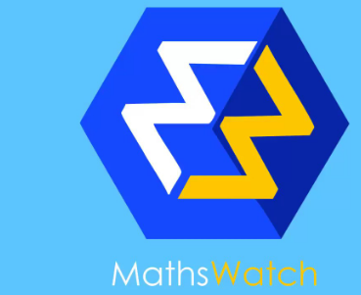
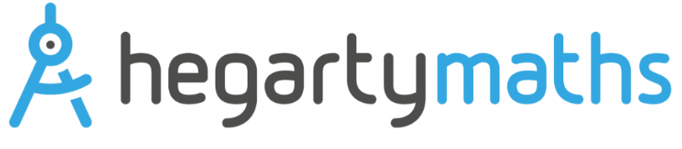

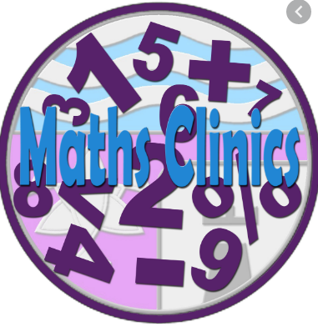
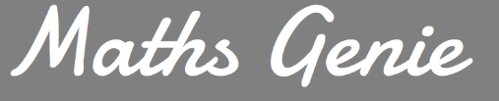
Online Platforms, Support and Results
Head of Mathematics: Mrs J Chopra
Email: j.chopra@maidenerleghtrust.org

Slide 7
FAQ’s
Q: Are students set according to ability
A: Yes, students will be tested on arrival to ensure that they receive the right level of support as well as challenge in their lessons
Q: How often will my child receive homework
A: Every week, students will receive homework on a weekly basis with different levels of challenge.
Q: How many students are there per class?
A: Top sets are usually larger with a maximum of 32 students. However, on average we benefit from smaller classes ranging from 15 – 28 students
Q: How many sets are there in Maths?
A: Usually 3 sets.
Q: My child usually struggles with Maths, is there any support available?
A: Yes, we have a weekly drop in session after school where students can approach their teachers for support. We also have online platforms available (MathsWatch and Hegarty) which can be accessed our students at any time. We also have TA support available and the possibility to branch out into smaller sub groups for intervention if required.
Q: My child enjoys mathematics and needs a higher level of challenge, what can the department do to support their needs?
A: We are a team of subject specialists and will move students onto a higher level of challenge (GCSE if need be) in lessons to ensure that your child continues to make progress and is appropriately challenged.

Slide 8
FAQ’s
Q What are your results like as a department?
A: We are one of the best preforming departments in the school. We have benefited with a positive progress 8 score and continue to improve on this year by year.
Q: How often are the students tested?
A: Students will be tested twice per half term. On arrival, students will receive a baseline test from which they will be set accordingly. Students will usually set one end of topic test and one end of term test.
Q: Which exam board will the students sit as part of their GCSE exams?
A: Our students will sit the Edexcel exam board.
Q: How many exam papers are there in Maths and how long are they?
A: There are three papers, each 1h 30 minutes long. Students will entered into either higher tier (grade 9-3) or Foundation Tier (grades 5-1)
For more information please email j.chopra@maidenerleghtrust.org

