Slide 1
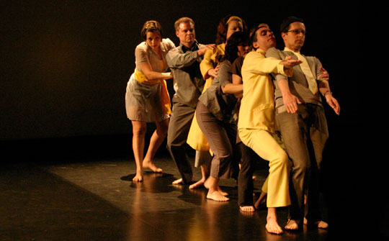
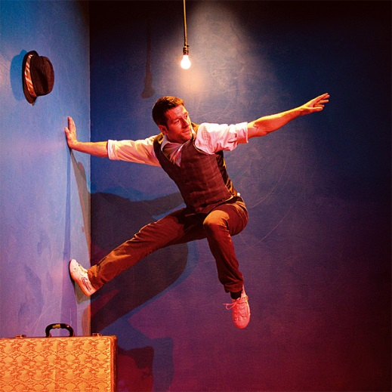
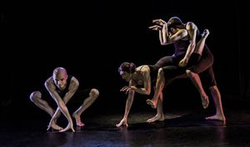
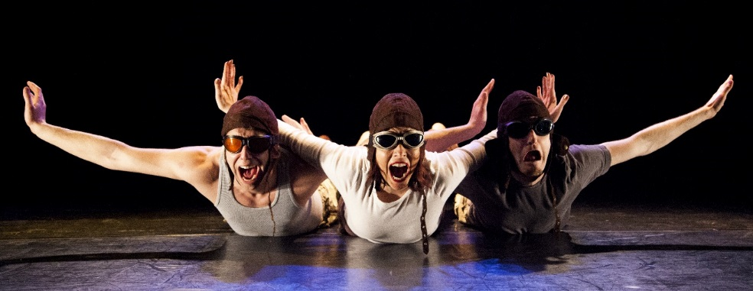
Physical Theatre
1
Autumn 2
Year 8

Slide 2
Learning Objective
To be able to use your imagination to convey non-naturalistic Drama and evaluate your own and your peers’ work effectively using subject specific vocabulary.

Slide 3
LO: To be able to use your imagination to convey non-naturalistic Drama and evaluate your own and your peers’ work effectively using subject specific vocabulary.
What is Physical Theatre?
In groups of 4
Mind map what you think is meant by the term Physical Theatre?
What techniques do you think are most used in Physical Theatre?
You have 3 minutes.
Express through movement
Makes audience think
Over-exaggeration
PHYSICAL THEATRE???
Challenges the idea of ‘traditional’ theatre
Visual Theatre
Appeals to the audience on an emotional level
Physicality of body

Slide 4




Object Transformation
LO: To be able to use your imagination to convey non-naturalistic Drama and evaluate your own and your peers’ work effectively using subject specific vocabulary.
Task:
Sit in a large circle
Place a chair in the middle.
This is no longer a chair – it can be anything!
One at a time you will transform this chair into something other than a chair.
You have to be imaginative.
Use the success criteria to help guide you.
Success Criteria:
Object transformation requires you to:
Turn the object in to ANYTHING
You need to use your IMAGINATION
Look around the room to help your ideas
Think of every day items.
Use movement
Use sound
Use over exaggeration
Mini Plenary
Why would actors/theatre companies use objects like a chair to represent other items?

Slide 5
Objects
LO: To be able to use your imagination to convey non-naturalistic Drama and evaluate your own and your peers’ work effectively using subject specific vocabulary.
Success Criteria:
To successfully secure an A grade you must:
Use your body to convey non-naturalistic objects.
By consistently using:
Teamwork
Body in performance
Levels
Gestures
Over Exaggeration
Space
Posture
Mini Plenary
What do you think their object is?
Why do you think that?
How effective was their body in performance?
How could have they used their bodies more effectively?
TASK OBJECTIVES:
Get in to groups of 5 /6
In your groups you need to work as a team!
You will be given an object.
You need to show that object by representing it through the PHYSICALITY OF YOUR BODY!
At the moment it MUST NOT MOVE OR MAKE SOUND.
Everyone in the group MUST be involved.
You are NOT to be a HUMAN in the OBJECT!
Don’t inform other groups, we will guess what your object is.
You only have 2 minutes!!!!!
Notes:
Issue students with a sticky note, on the sticky note write down an object for them to create using their whole bodies as a group. Suggestions of objects could be; Bicycle, Piano, Drum Kit, Clock, Car

Slide 6
LO: To be able to use your imagination to convey non-naturalistic Drama and evaluate your own and your peers’ work effectively using subject specific vocabulary.
Machines
Non-Human
Success Criteria:
To successfully secure an A grade you must:
Use your body to convey non-naturalistic machines.
By consistently using:
Teamwork
Body in performance
Levels
Gestures
Over Exaggeration
Space
Posture
Repetition
Movement
Noise
Volume
Climax
What qualities do machines have?
Repetitive
Noisy
Let’s get practical!!
As a group you need to think of a machine.
In your group you are now going to re create this machine using the physicality of your bodies.
What do you need to think about?

Slide 7
Perform & Evaluate
LO: To be able to use your imagination to convey non-naturalistic Drama and evaluate your own and your peers’ work effectively using subject specific vocabulary.
Plenary
On your way out the door, tell me one thing that you have learnt about Physical Theatre this lesson?
Success Criteria:
To successfully secure an A grade you must:
Use your body to convey non-naturalistic machines.
By consistently using:
Teamwork
Body in performance
Levels
Gestures
Over Exaggeration
Space
Posture
Repetition
Movement
Noise
Volume
Climax
What techniques worked specifically well in their machine?
How did they use their bodies in performance?
Why do you think theatre companies use body propping?
How could have you improved this lesson?

